Slide 1
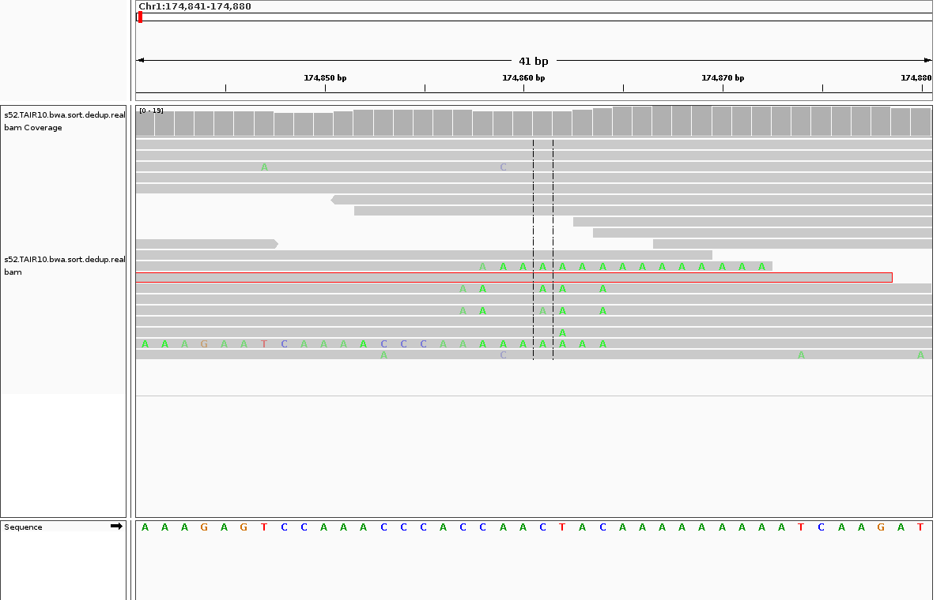
Chr1:174857-174864 in sample “52”
Chr1:174857:C>A
Chr1:174858:C>A
Chr1:174861:C>A
Chr1:174862:T>A
Chr1:174864:C>A

Slide 2
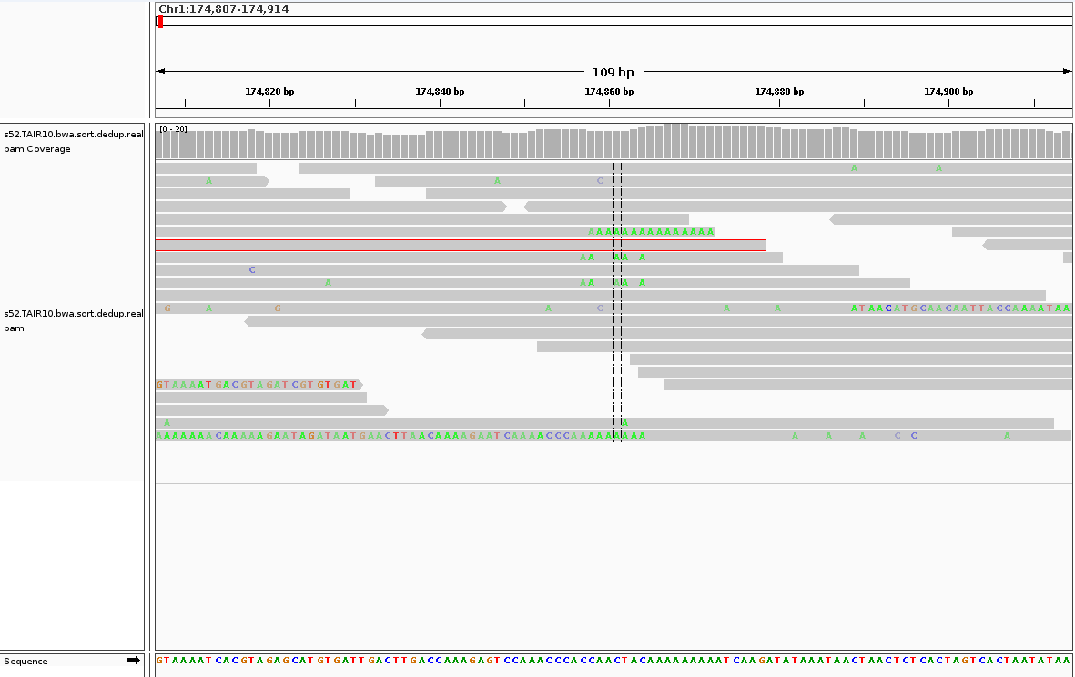
This figure shows the strand bias in Chr1:174857-174864 in sample “52”, all X -> A mutations are of the strand indicated by the arrow

Slide 3
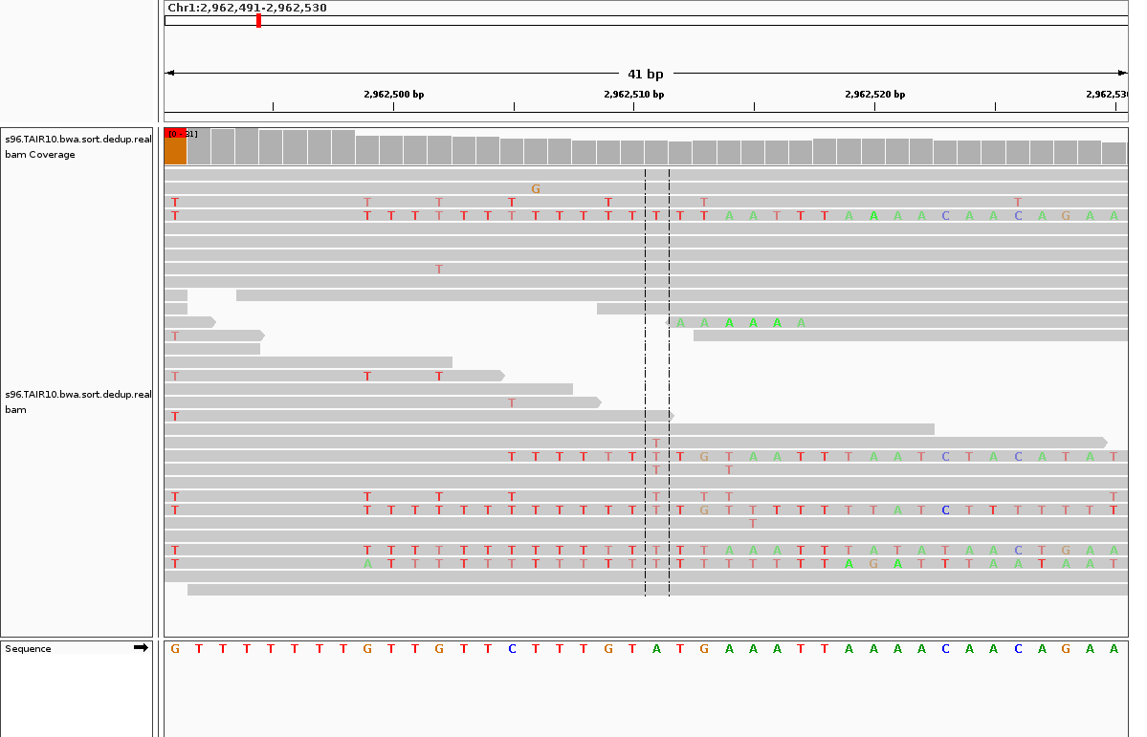
Chr1:2962509-2962513 in sample “96”
Chr1:2962509:G>T
Chr1:2962513:G>T

Slide 4
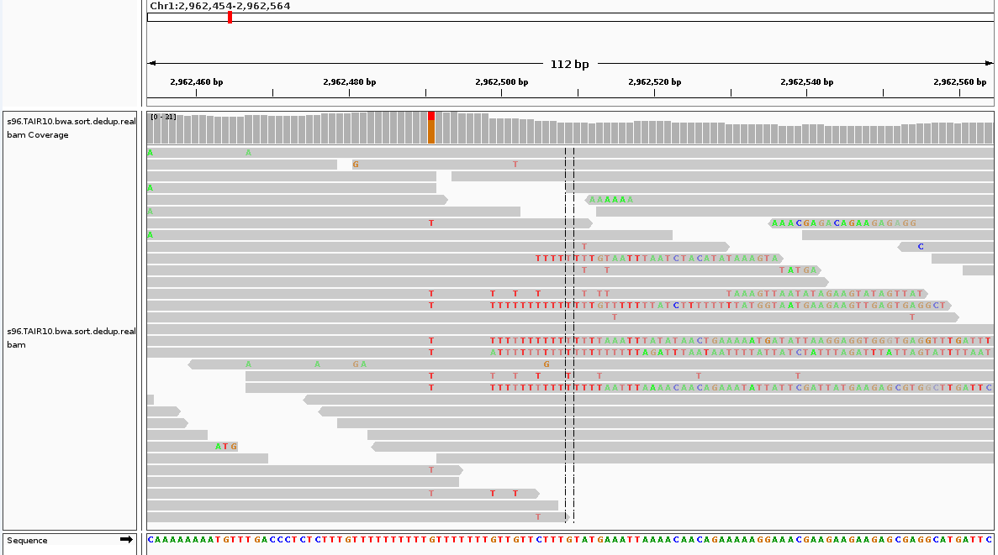
This figure shows the strand bias in Chr1:2962509-2962513 in sample “96”, all X -> T mutations are of the strand indicated by the arrow

Slide 5
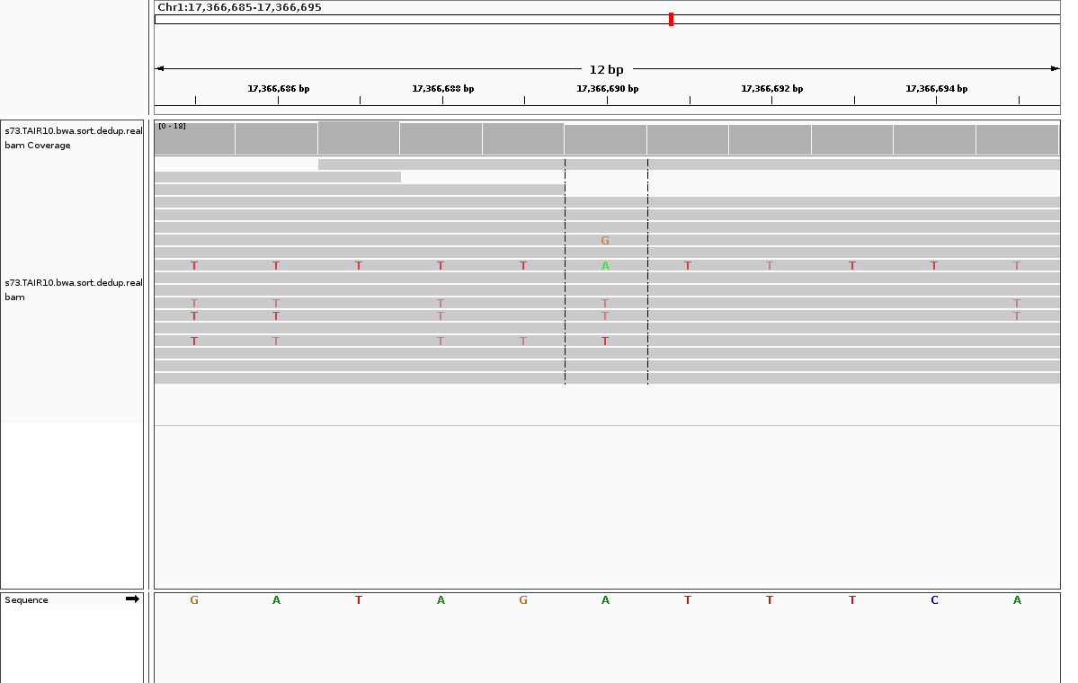
Chr1:17366685-17366695 in sample “73”
Chr1:17366685:G>T
Chr1:17366686:A>T
Chr1:17366688:A>T
Chr1:17366690:A>T
Chr1:17366695:A>T

Slide 6
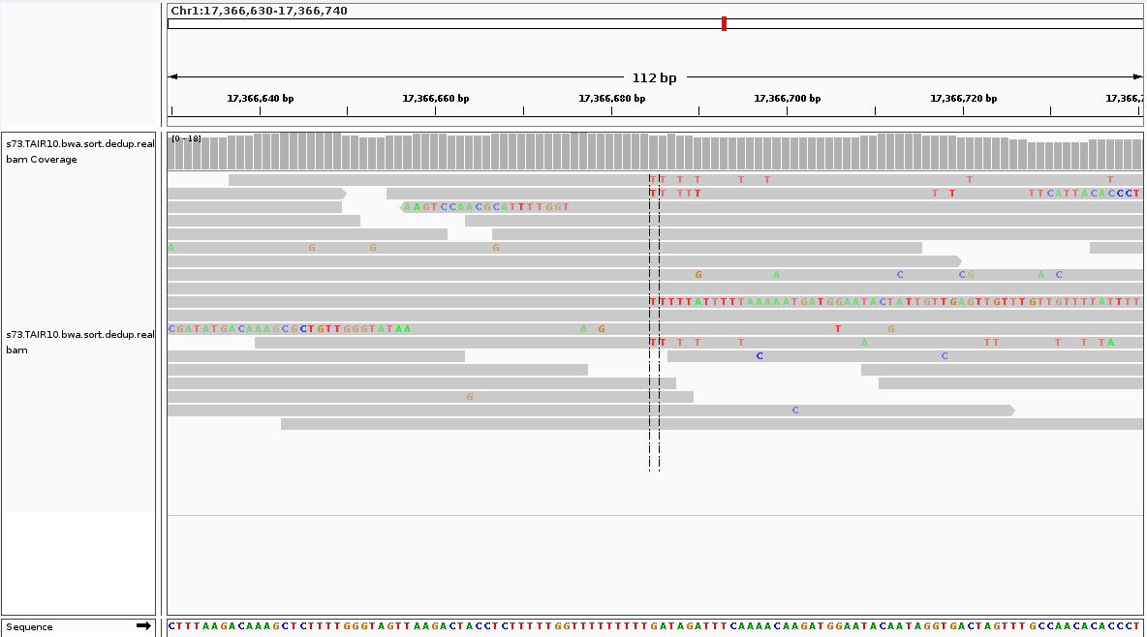
This figure shows the strand bias in Chr1:17366685-17366695 in sample “73”, all X -> T mutations are of the strand indicated by the arrow

Slide 7
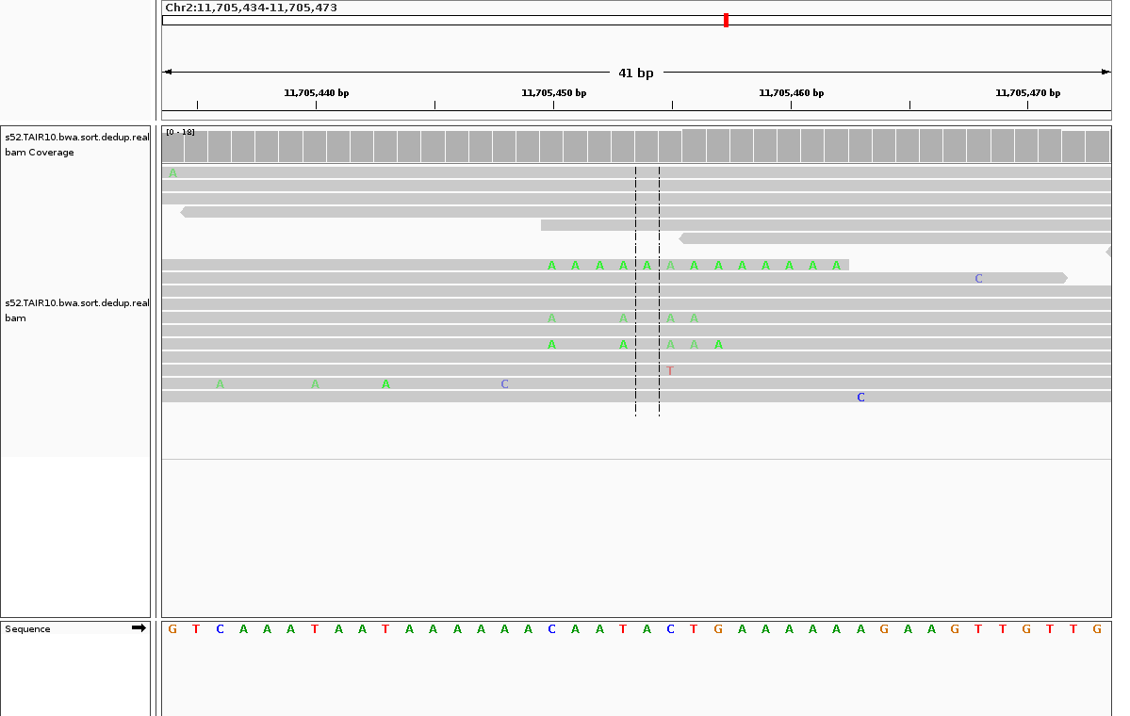
Chr2:11705450-11705457 in sample “52”
Chr2:11705450:C>A
Chr2:11705453:T>A
Chr2:11705455:C>A
Chr2:11705456:T>A
Chr2:11705457:G>A

Slide 8
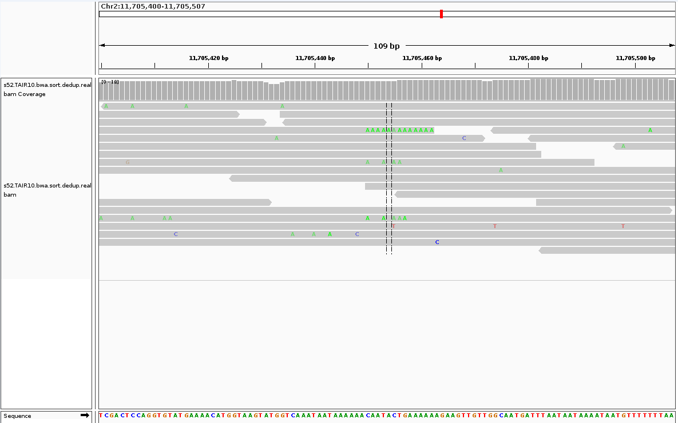
This figure shows the strand bias in Chr2:11705450-11705457 in sample “52”, all X -> A mutations are of the strand indicated by the arrow

Slide 9
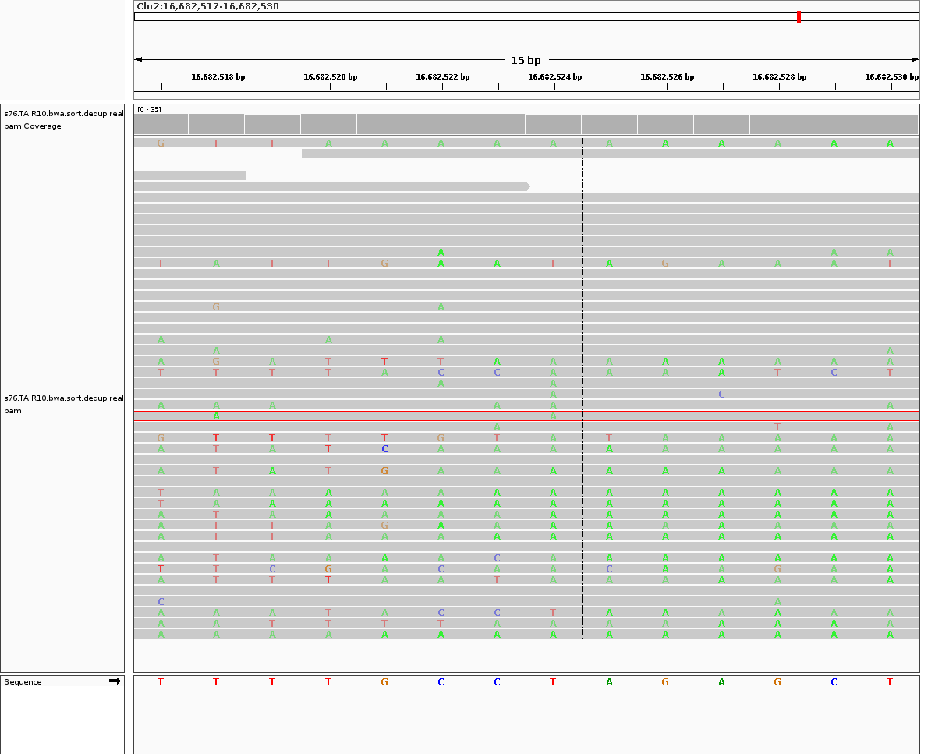
Chr2:16682517-16682530 in sample “76”
Chr2:16682517:T>A
Chr2:16682518:T>A
Chr2:16682519:T>A
Chr2:16682523:C>A
Chr2:16682524:T>A

Slide 10
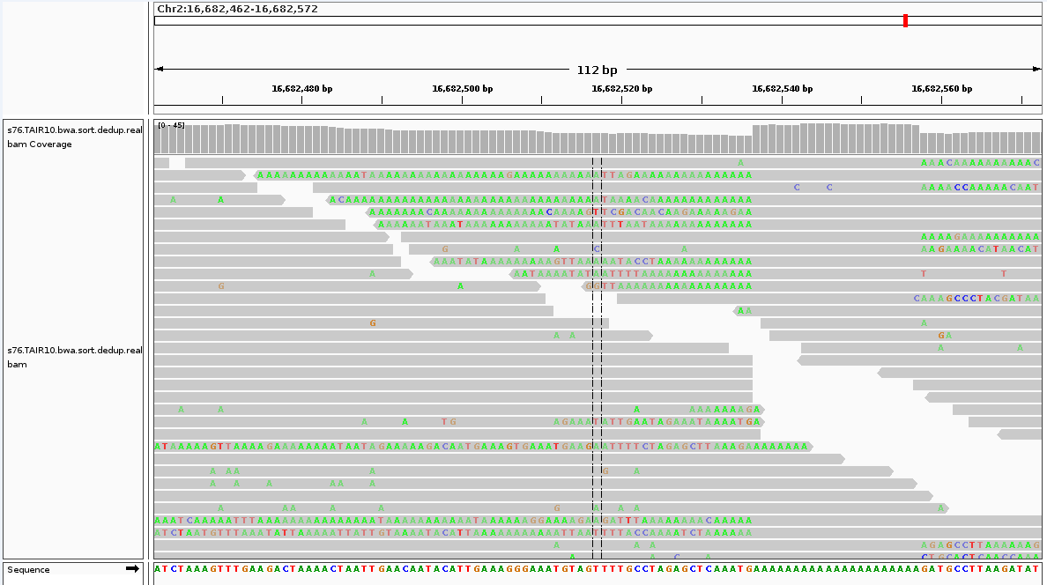
This figure shows the strand bias in Chr2:16682517-16682530 in sample “76”, all X -> A mutations are of the strand indicated by the arrow

Slide 11
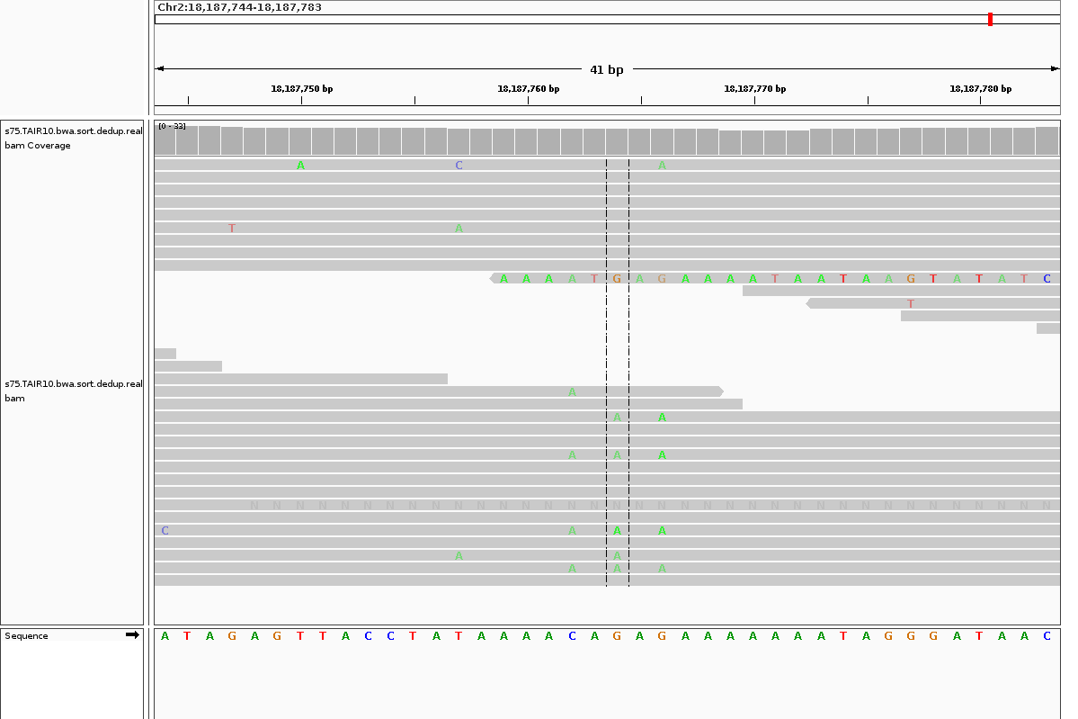
Chr2:18187762-18187766 in sample “75”
Chr2:18187762:C>A
Chr2:18187764:G>A
Chr2:18187766:G>A

Slide 12
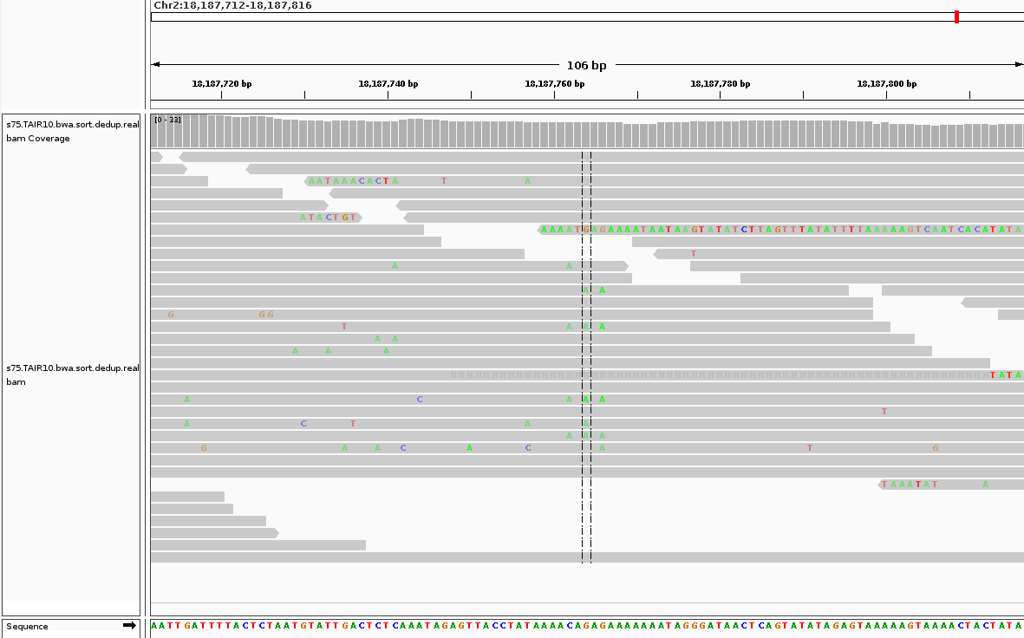
This figure shows the strand bias in Chr2:18187762-18187766 in sample “75”, all X -> A mutations are of the strand indicated by the arrow

Slide 13
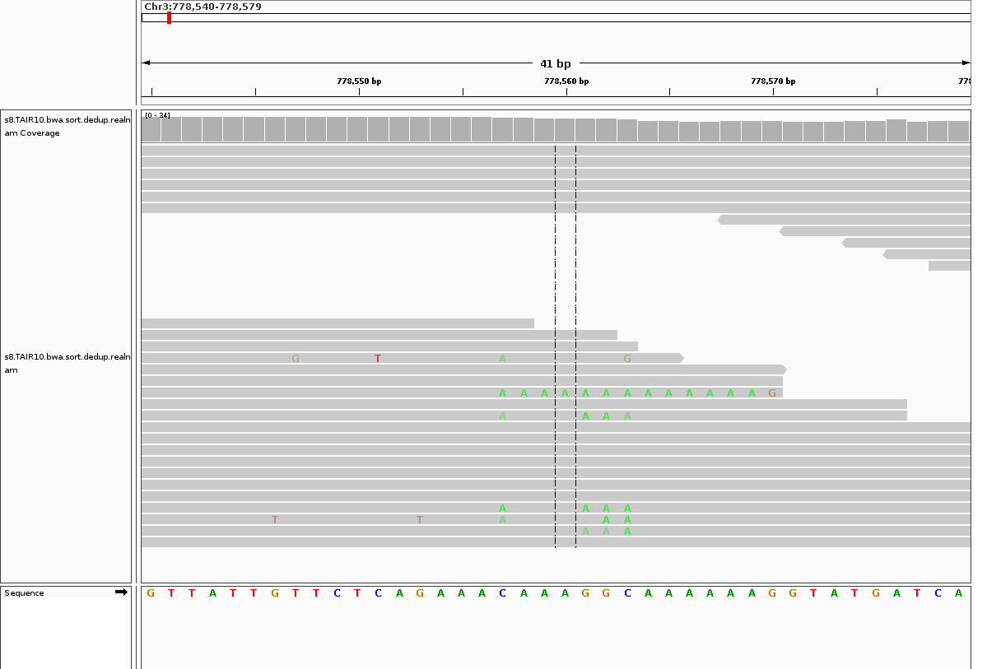
Chr3:778557-778563 in sample “8R”
Chr3:778557:C>A
Chr3:778561:G>A
Chr3:778562:G>A
Chr3:778563:C>A

Slide 14
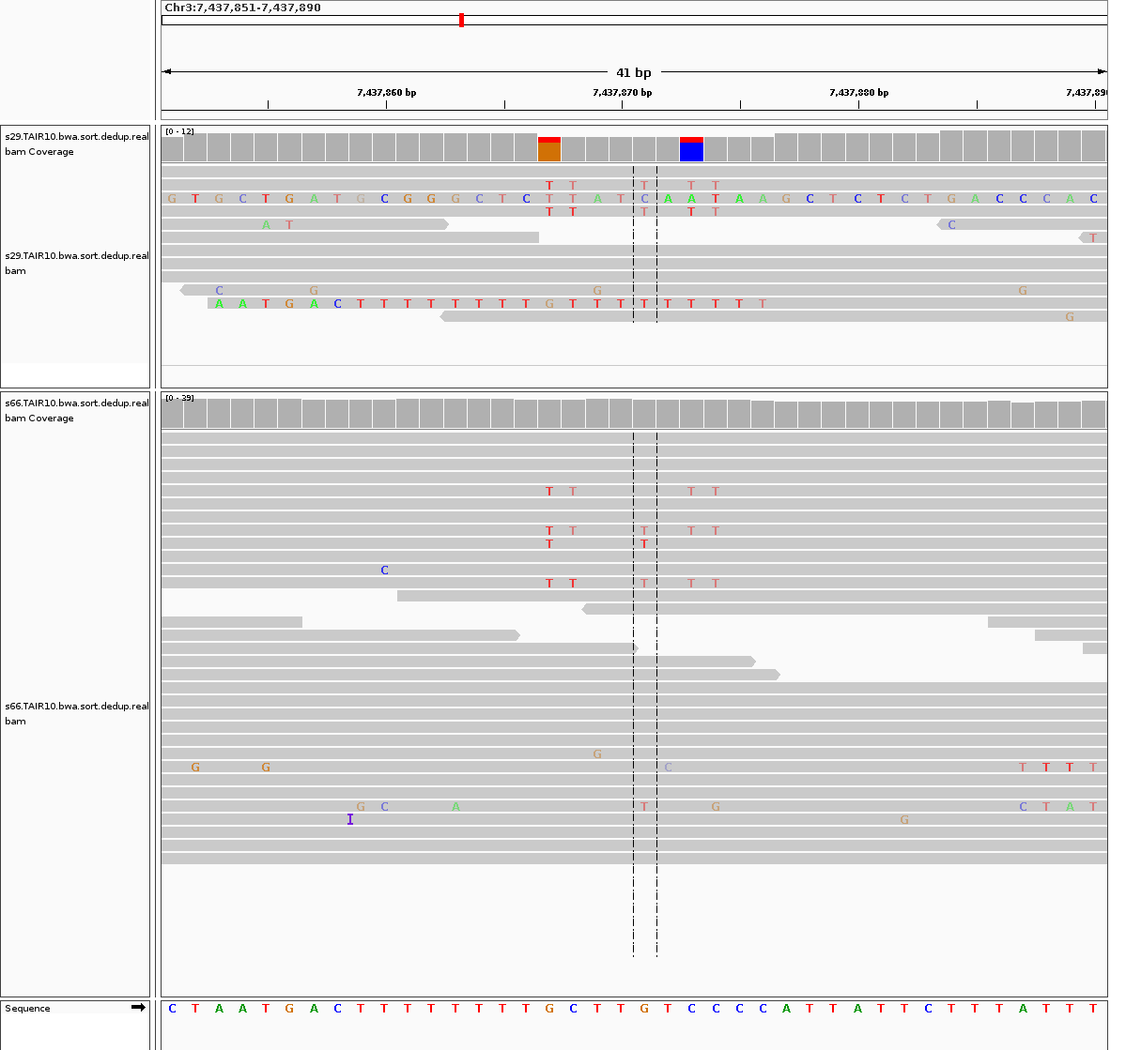
Chr3_7437867-7437874 in samples “29” and “66”
Chr3:7437867:G>T
Chr3:7437868:C>T
Chr3:7437871:G>T
Chr3:7437873:C>T
Chr3:7437874:C>T

Slide 15
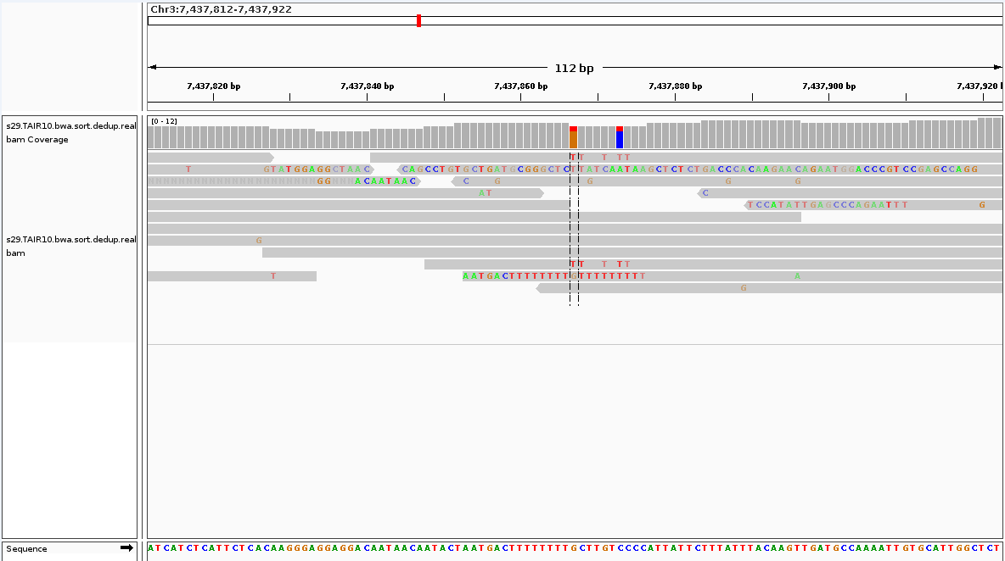
This figure shows the strand bias in Chr3_7437867-7437874 in samples “29”, all X -> T mutations are of the strand indicated by the arrow

Slide 16
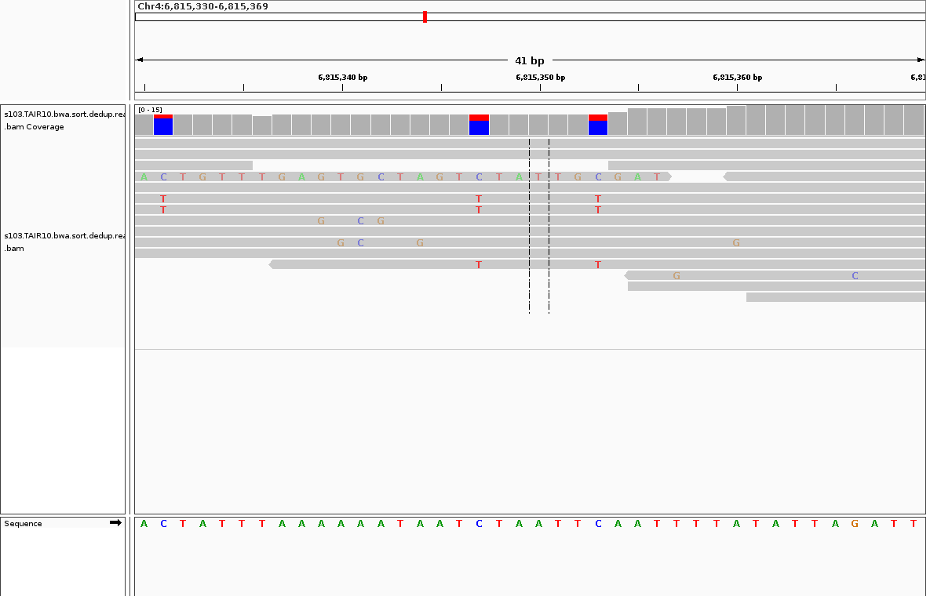
Chr4:6815347-6815353 in sample “103”
Chr4:6815347:C>T
Chr4:6815353:C>T

Slide 17
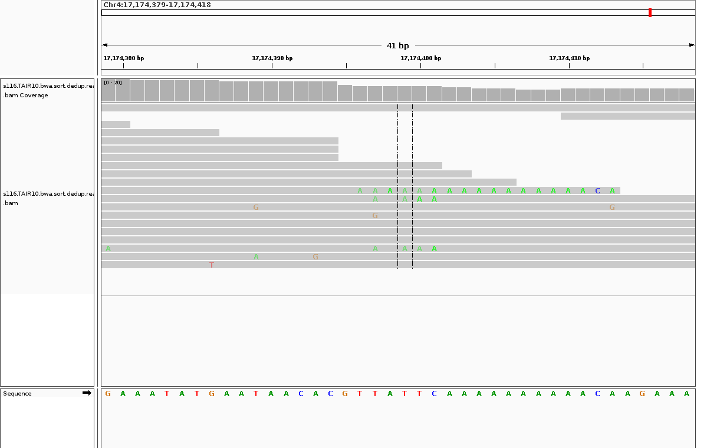
Chr4:17174397-17174401 in sample “116”
Chr4:17174397:T>A
Chr4:17174399:T>A
Chr4:17174400:T>A
Chr4:17174401:C>A

Slide 18
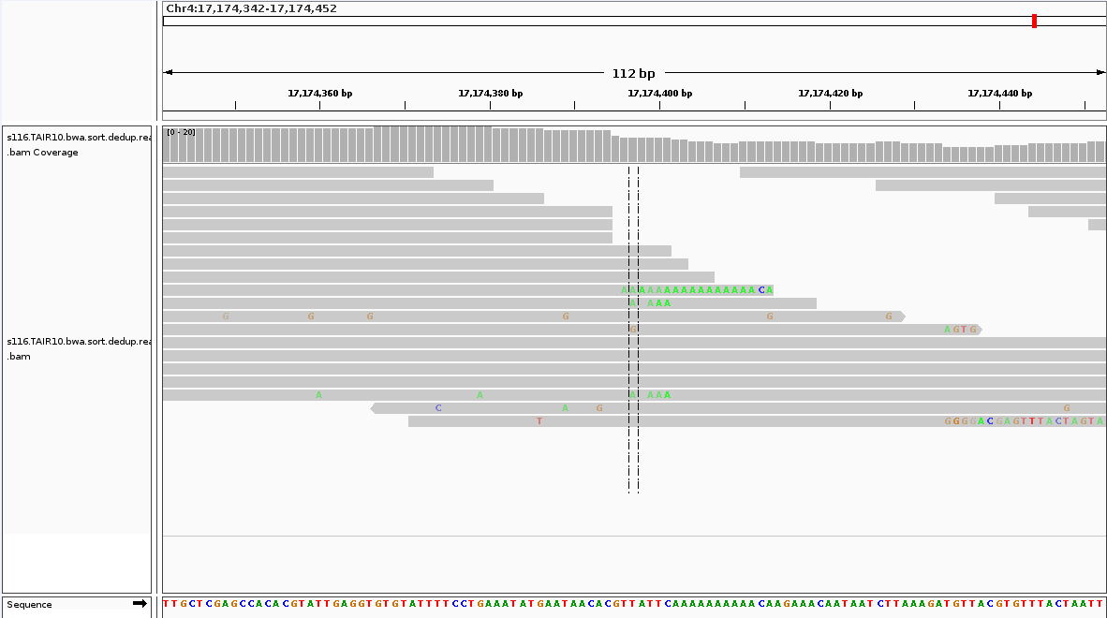
This figure shows the strand bias in Chr4:17174397-17174401 in sample “116”, all X -> T mutations are of the strand indicated by the arrow

Slide 19
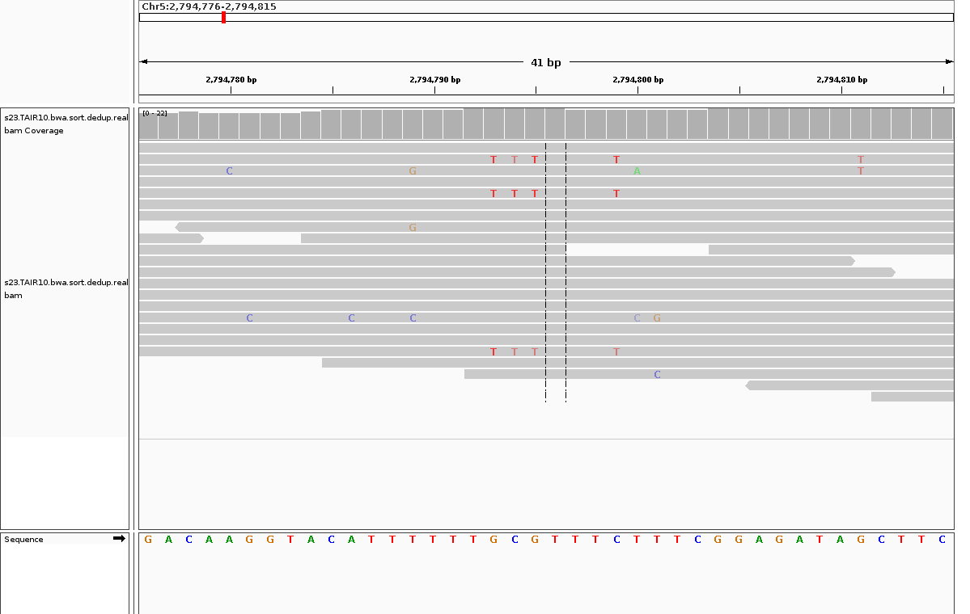
Chr5:2794793-2794799 in sample “23”
Chr5:2794793:G>T
Chr5:2794794:C>T
Chr5:2794795:G>T
Chr5:2794799:C>T

Slide 20
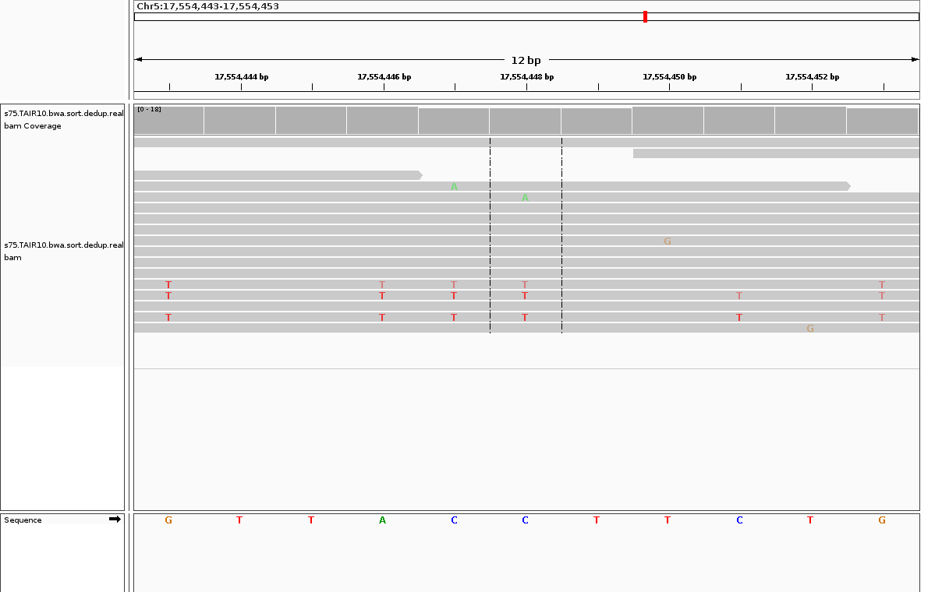
Chr5:17554443-17554453 in sample “75”
Chr5:17554443:G>T
Chr5:17554446:A>T
Chr5:17554447:C>T
Chr5:17554448:C>T
Chr5:17554451:C>T
Chr5:17554453:G>T

Slide 21
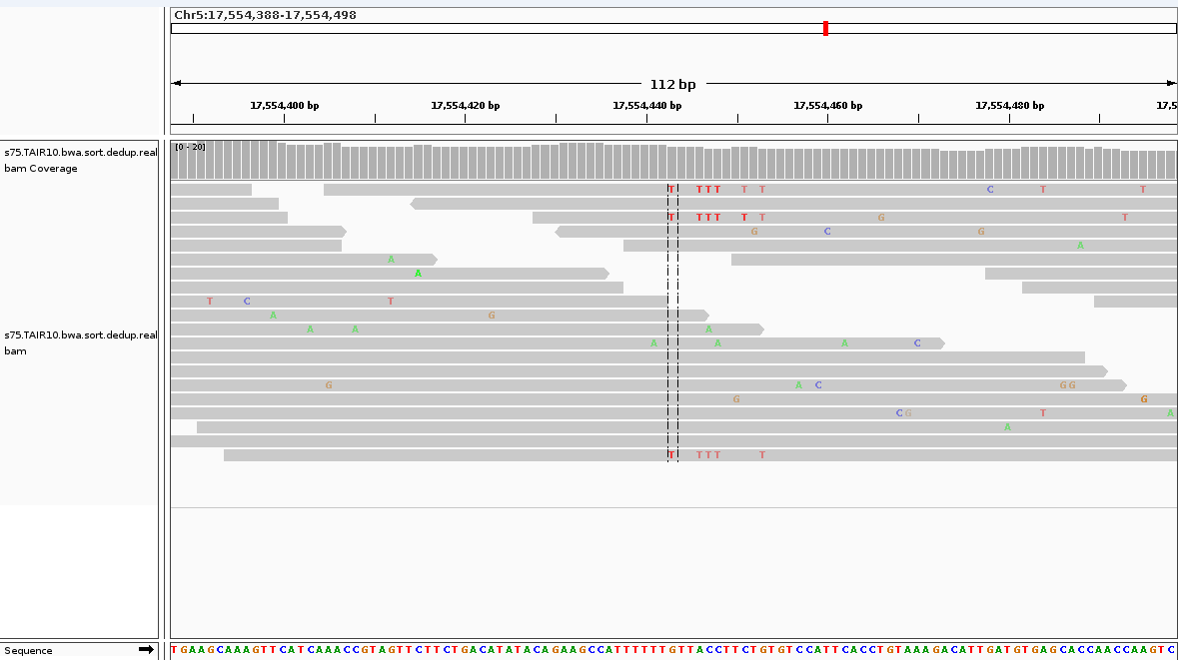
This figure shows the strand bias in Chr5:17554443-17554453 in sample “75”, all X -> T mutations are of the strand indicated by the arrow

